Slide 1
Advanced higher Graphic communication
Technical Drawing Standards, Protocols and Conventions?

Slide 2
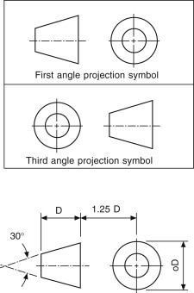
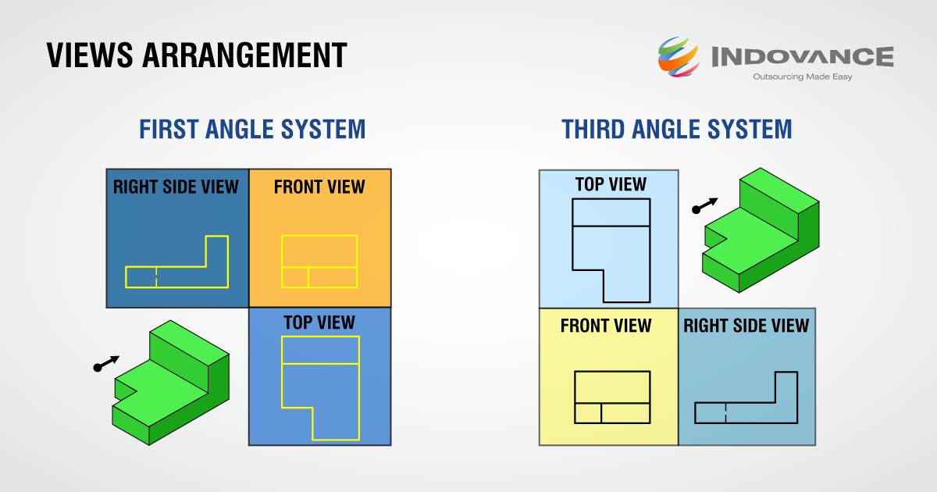
Projection Methods
Drawing Standards
Projection Methods.
There are several international standards, professions must be aware of the correct standard to use. Each standard will employ either FIRST ANGLE or THIRD ANGLE projection methods. The symbols used to denote which projection method is being used are shown below. This will be clearly produced in the title block of a production drawing.

Slide 3
Line types
Line Types
Production drawings should use the correct line thickness and type to ensure clarity.
The table below shows the relevant line types and an application of them in the image over.

Slide 4
Threads
Screw Threads and Threaded Parts
Screw threads, both internal and external need to be represented using the correct convention.
In an external thread, a continuous thin line is represented inside the outline of the shape.
In an internal thread, a continuous thin line is represented outside the outline of the hole.

Slide 5
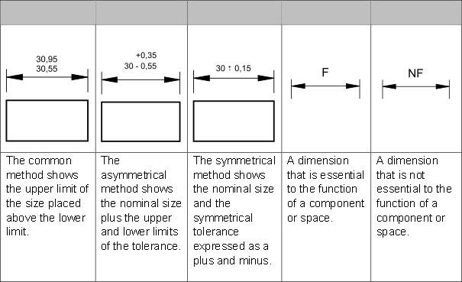
Tolerances
Tolerances
When manufacturing or constructing an item it is virtually impossible to achieve precisely the required size of the item. The error permissible in manufacture is called the tolerance.
Tolerance which affect the function of an object or features on it are referred to as functional tolerances.
Below are the common methods for applying a tolerance to a production drawing.

Slide 6
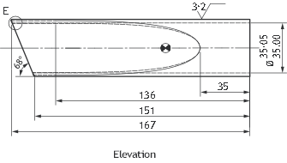
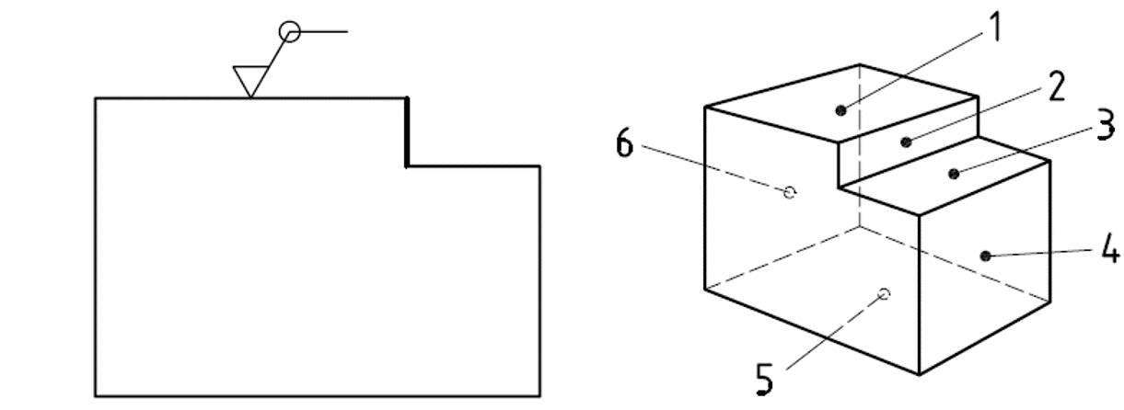
Surface Finish
Surface Finish
Surface roughness is the measurement of the relative smoothness of a surface’s profile, calculated via the microscopic deviations in a surface's true form. The larger the deviation from its true form, the rougher the surface, whilst the smaller the deviation, the smoother the surface.
When applying a surface texture symbol to a production drawing there are three main types, shown below.
When the same surface finish is required on all surfaces around a work piece, a circle is added to the graphical symbol as shown.
Basic Symbol for surface texture
Removal of material required
Removal of material not permitted

Slide 7
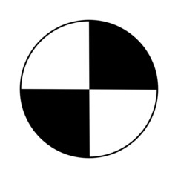
Centre of Gravity
Centre of Gravity
A centre of gravity mark on a production drawing serves the purpose of indicating the exact location of the centre of gravity for a particular object or assembly. This information is essential for various engineering and manufacturing applications, especially when designing and fabricating objects that need to be balanced or stable.
Shown below is the symbol used to indicate the centre of gravity on a drawing.

Slide 8
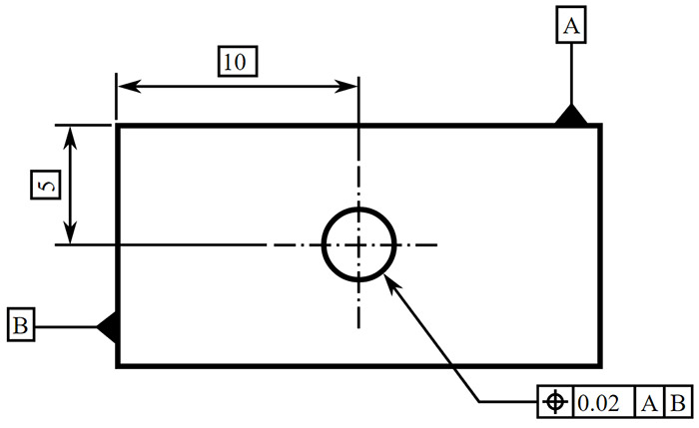
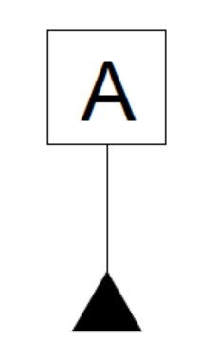
Datums
Use of Datums
Datums are used to show that a planar surface or the axis of a round feature serves as the reference datum for dimensioning.
A datum is an origin from which the location or geometric characteristics of features of a part are established.
This is often used to show where the parallel dimensioning starts from and stops the accumulation of tolerances on a component.
The symbol used for a datum is shown below.

